Slide 1

Creating Dashboards with Potly and Dash

Slide 2
Objectives
Demonstrate adding different dashboard elements including text boxes, dropdown, graphs, and others.
Apply interactivity to dash core and HTML components.
Describe how a dashboard can be used to answer critical business questions.
Create Dashboards

Slide 3
Introduction to Dash
Dash is a Open-Source User Interface Python library for creating reactive, web-based applications.
Easy to build GUI
Declarative and Reactive
Rendered in web browser and can be deployd to servers
Inherently cross-platform and mobile ready
Create Dashboards

Slide 4
Introduction to Dash
You are planning to create an application to answer a business question.
  First step: determine the layout( called Dash) of the application. →Decide which chart to use and where to place for example.
  Second part: add interactivity to the application.
Dash components:
  Core components
  import dash_core_components as dcc
  HTML Components
  import dash_html_components as html
Create Dashboards

Slide 5
Make dashboards interactive
Dash – Callbacks:
  A callback function is a python function that is automatically called by Dash whenever an input component's property changes.
  Callback function is decorated with `@app.callback` decorator.
What this decorator tells Dash?
  Whenever there is a change in the input component value, callback function wrapped by the decorator is called followed by the update to the output component children in the application layout.
Create Dashboards

Slide 6
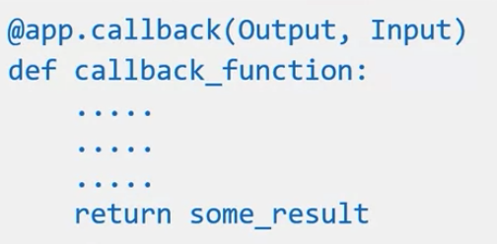
Make dashboards interactive
Callback function
  Function that will perform operations to return the desired result for the output component.
  Decorate the callback function with @app.callback decorator.
  Output : This sets result returned from the callback function
  Input: input provided to the callback function
  Based on the input change, the output will change.
Create Dashboards

Slide 7
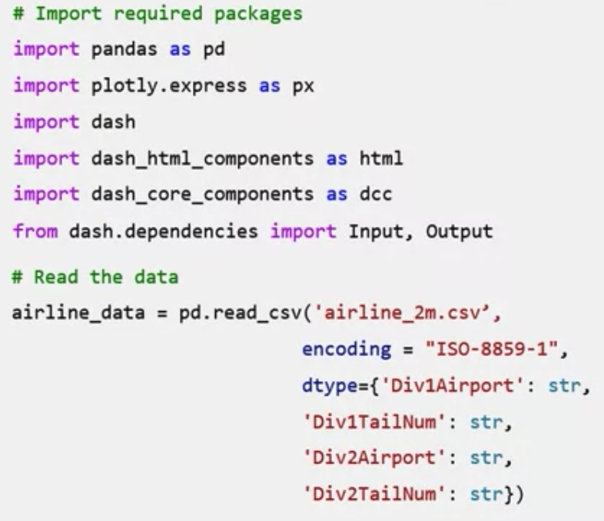
Make dashboards interactive
Try this code and show the results
Create Dashboards

Slide 8
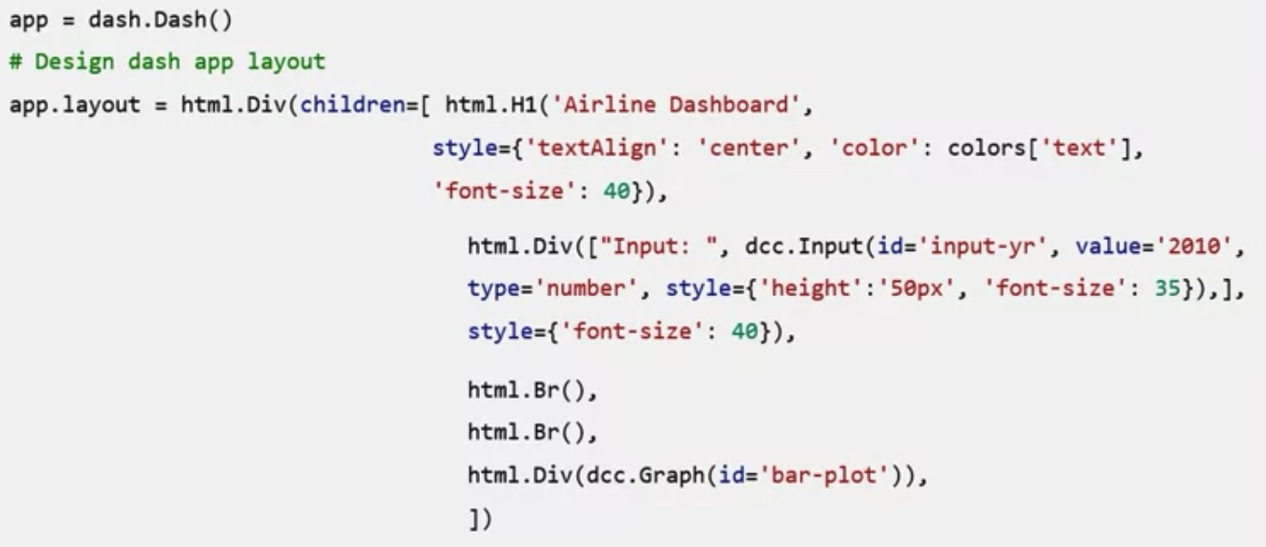
Make dashboards interactive
Try this code and show the results
Create Dashboards

Slide 9
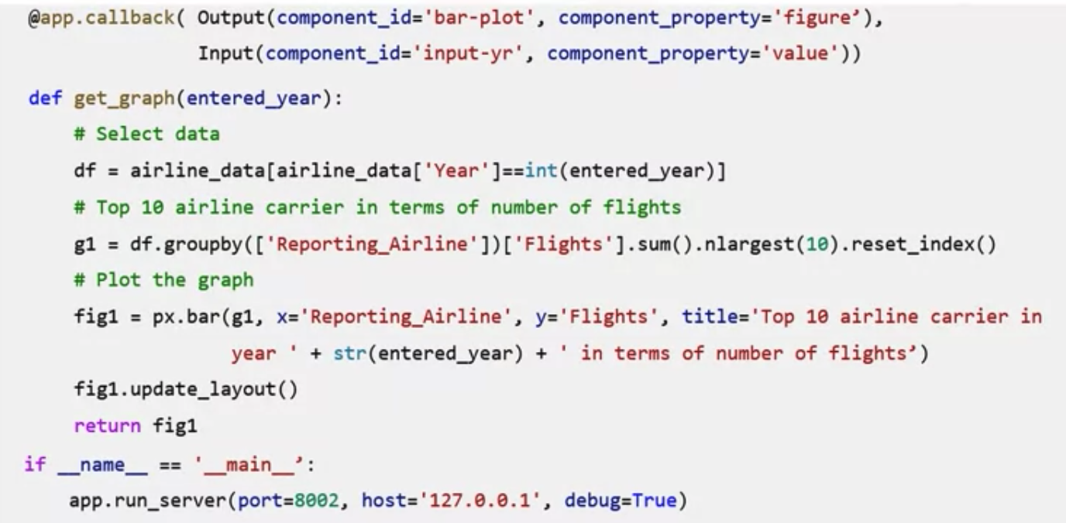
Make dashboards interactive
Try this code and show the results
Create Dashboards

Slide 10
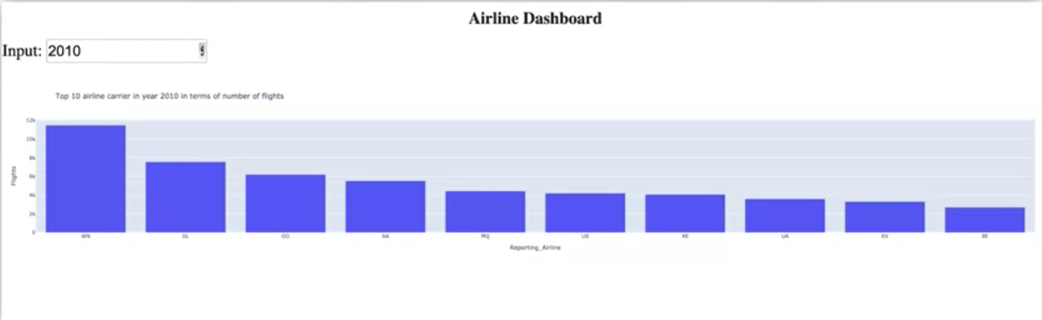
Make dashboards interactive
The result with one input parameter
  When input change→ output will change
Create Dashboards

Slide 11
Make dashboards interactive
Callback with two inputs
Create Dashboards

Slide 12
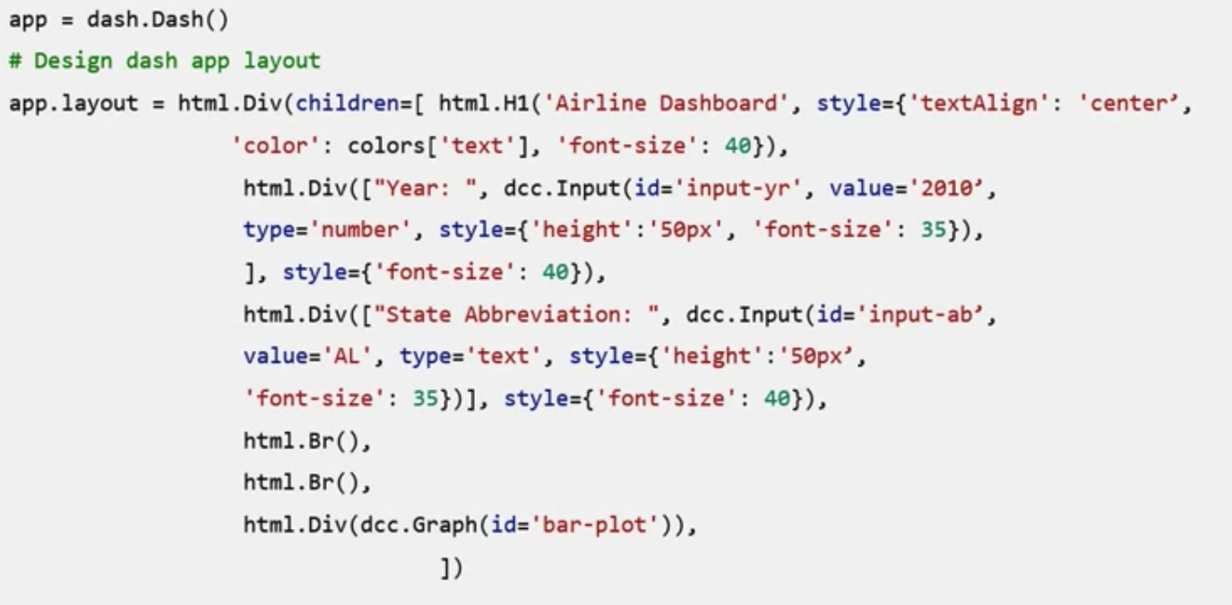
Make dashboards interactive
Callback with two inputs
Create Dashboards

Slide 13
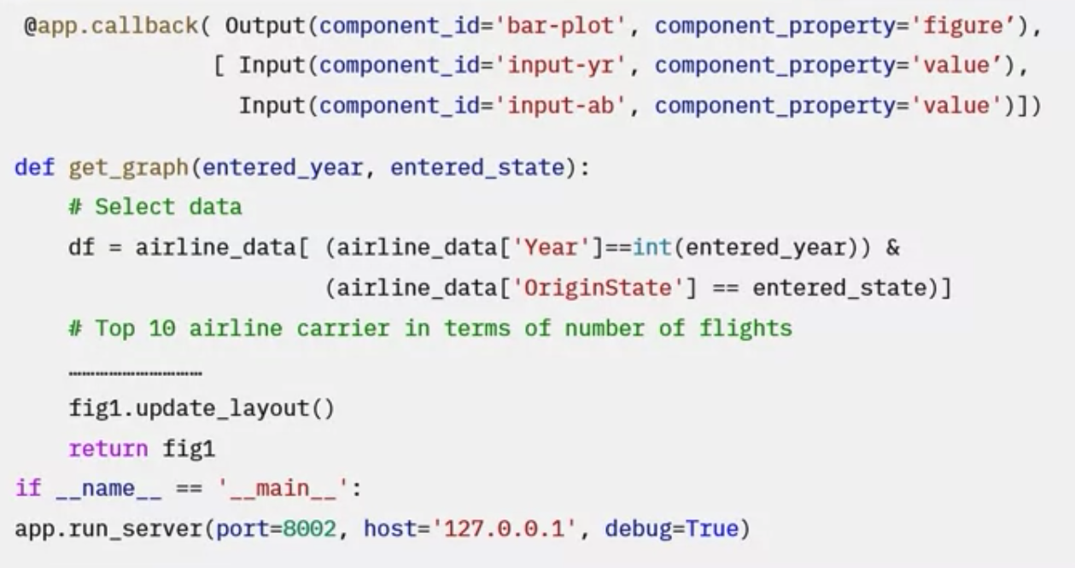
Make dashboards interactive
Callback with two inputs
Create Dashboards

Slide 14
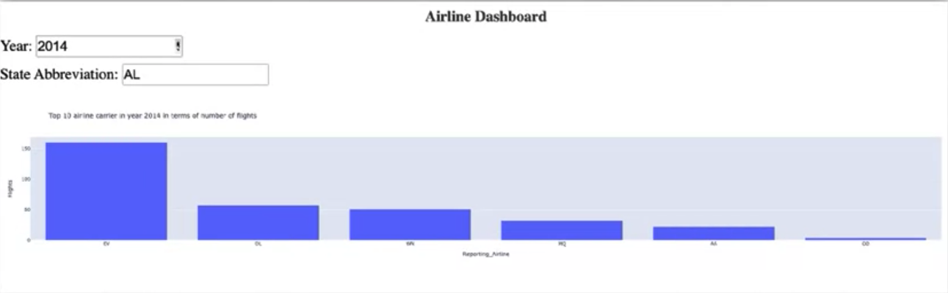
Make dashboards interactive
Callback with two inputs
  Year change→ output will change
  State change→ output will change
Create Dashboards

Slide 15
Summary
Demonstrate adding different dashboard elements including text boxes, dropdown, graphs, and others.
Apply interactivity to dash core and HTML components.
Describe how a dashboard can be used to answer critical business questions.
Create Dashboards

Slide 16
Q & A
Create Dashboards

